Slide 1
13 – Model Performance
Dave Eargle – CU Boulder

Slide 2
Models can have varying complexity
… but what complexity is best?
Over-fitting the data
Finding chance occurrences in data that look like interesting patterns, but which do not generalize, is called over-fitting the data
We want models to apply not just to the exact training set but to the general population from which the training data came
Generalization

Slide 3
Over-fitting
Overfitting is: the tendency of DM procedures to tailor models to the training data, at the expense of generalization to previously unseen data points.
All data mining procedures have the tendency to over-fit to some extent
Some more than others.
“If you torture the data long enough, it will confess”
There is no single choice or procedure that will eliminate over-fitting
recognize over-fitting and manage complexity in a principled way.

Slide 4
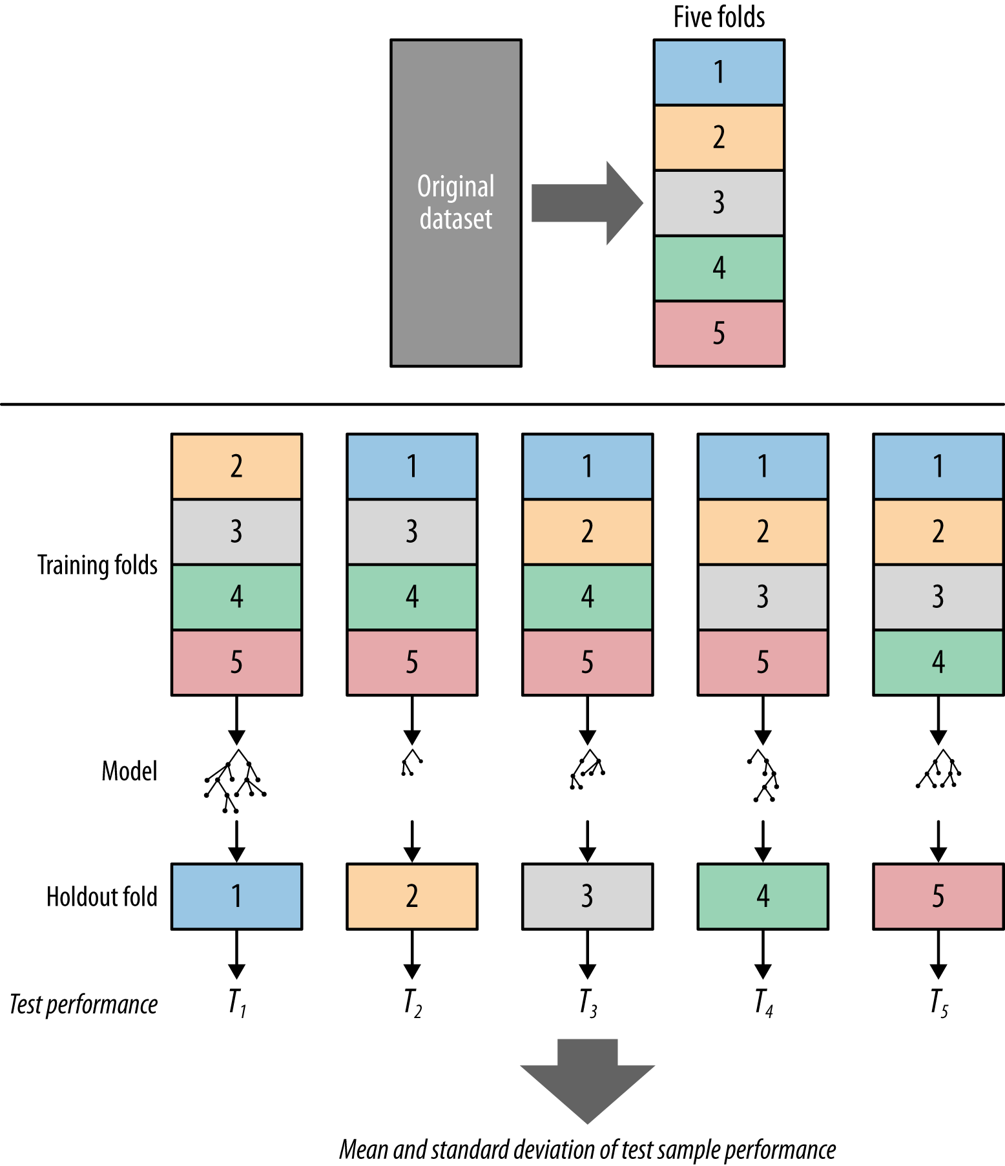
How to evaluate your models?
Option 1 – use the data to train a model, and then test its performance on the same data
What’s wrong with this approach?
Use to induce…
Test performance on…
Model

Slide 5
How to evaluate your models?
Option 2 – “holdout” a sample of your data to use as a “test” set.
Train
Use to induce…
Test performance on…
Model
Holdout
Holdout

Slide 6
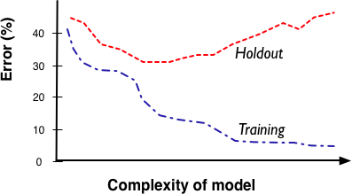
Fitting Graph

Slide 7
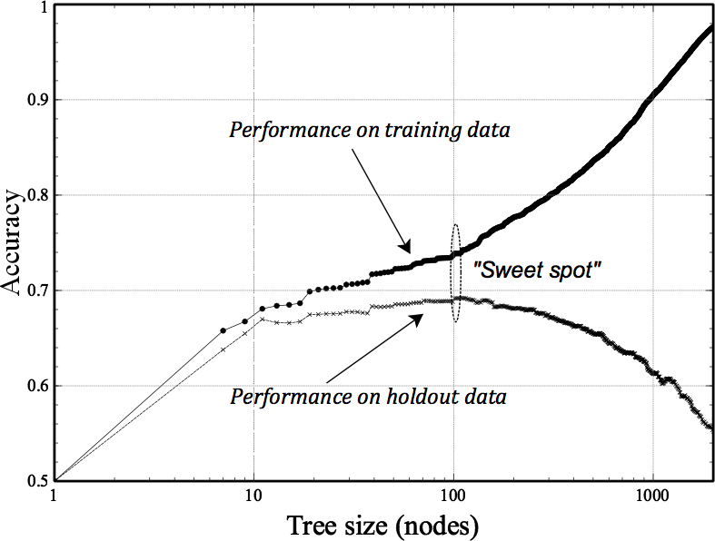
Over-fitting in tree induction

Slide 8
A note about decision tree complexity…
Complexity is only good up to a point
We can get an idea of when added complexity is no longer beneficial by splitting our “labeled” data into two datasets: “training” data and “testing” data
Train your model on the training data, measure accuracy
Then run your model on the test data, measure accuracy again
Compare over a range of complexity

Slide 9
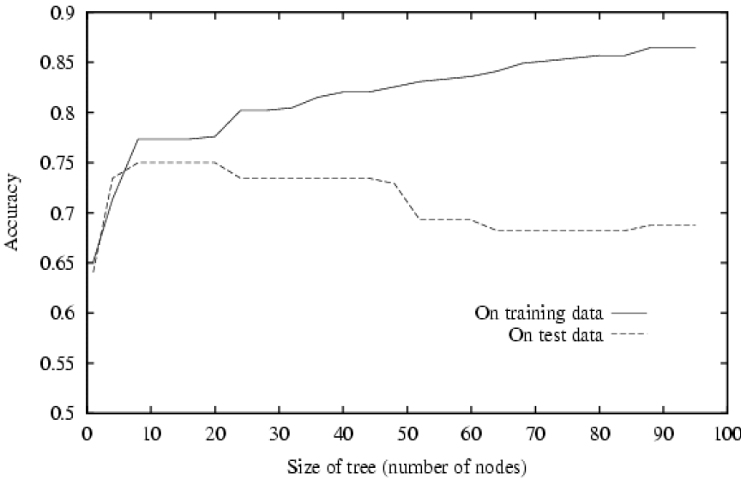
Tree Complexity and Over-fitting

Slide 10
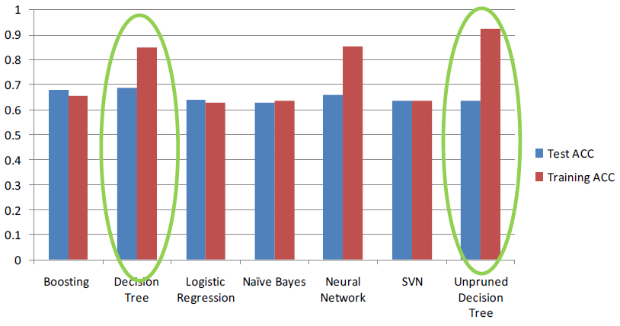
Tree Accuracy on a Churn dataset
“Unpruned” tree had higher accuracy against training data, but worse accuracy on testing data, compared to a “pruned” decision tree

Slide 11
Pruning
Pruning simplifies a decision tree to prevent over-fitting to noise in the data
Post-pruning:
takes a fully-grown decision tree and discards unreliable parts
Pre-pruning:
stops growing a branch when information becomes unreliable
Post-pruning preferred in practice

Slide 12
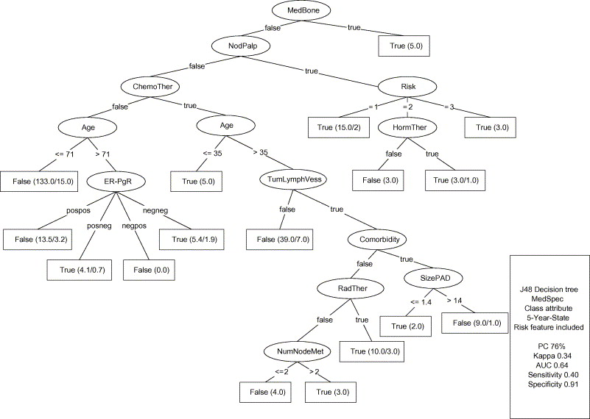

Post-pruning a tree

Slide 13
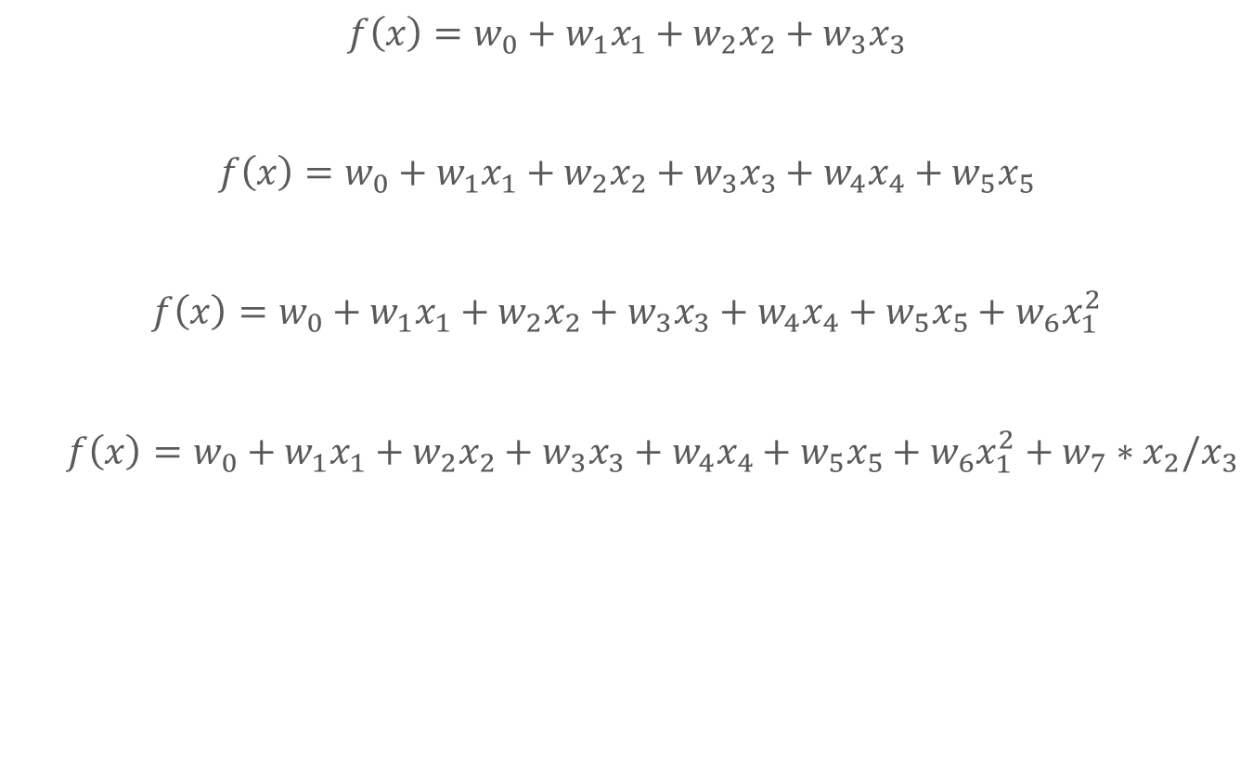
Over-fitting in linear discriminants
The more parameters we add, the more complex our model becomes.
More complexity = more able to fit patterns
More complexity = more likelihood of overfitting
Increasing Complexity
$f\left(x\right)=w_{0}+w_{1}x_{1}+w_{2}x_{2}+w_{3}x_{3}$
$f\left(x\right)=w_{0}+w_{1}x_{1}+w_{2}x_{2}+w_{3}x_{3}+w_{4}x_{4}+w_{5}x_{5}$
$f\left(x\right)=w_{0}+w_{1}x_{1}+w_{2}x_{2}+w_{3}x_{3}+w_{4}x_{4}+w_{5}x_{5}+w_{6}x_{1}^{2}$
$f\left(x\right)=w_{0}+w_{1}x_{1}+w_{2}x_{2}+w_{3}x_{3}+w_{4}x_{4}+w_{5}x_{5}+w_{6}x_{1}^{2}+w_{7}∗x_{2}/x_{3}$

Slide 14
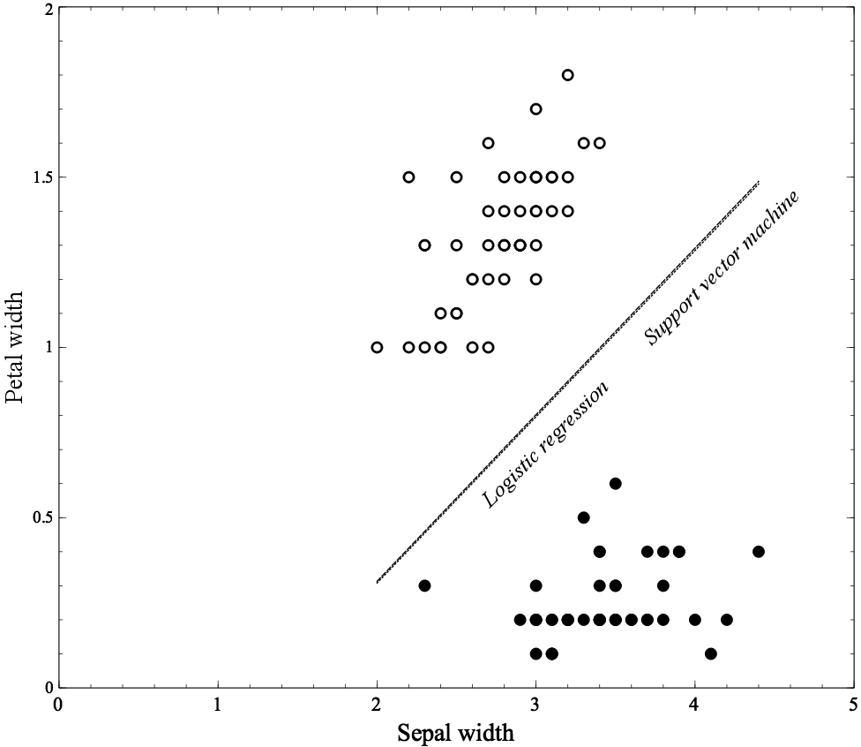
Example: Classifying Flowers

Slide 15
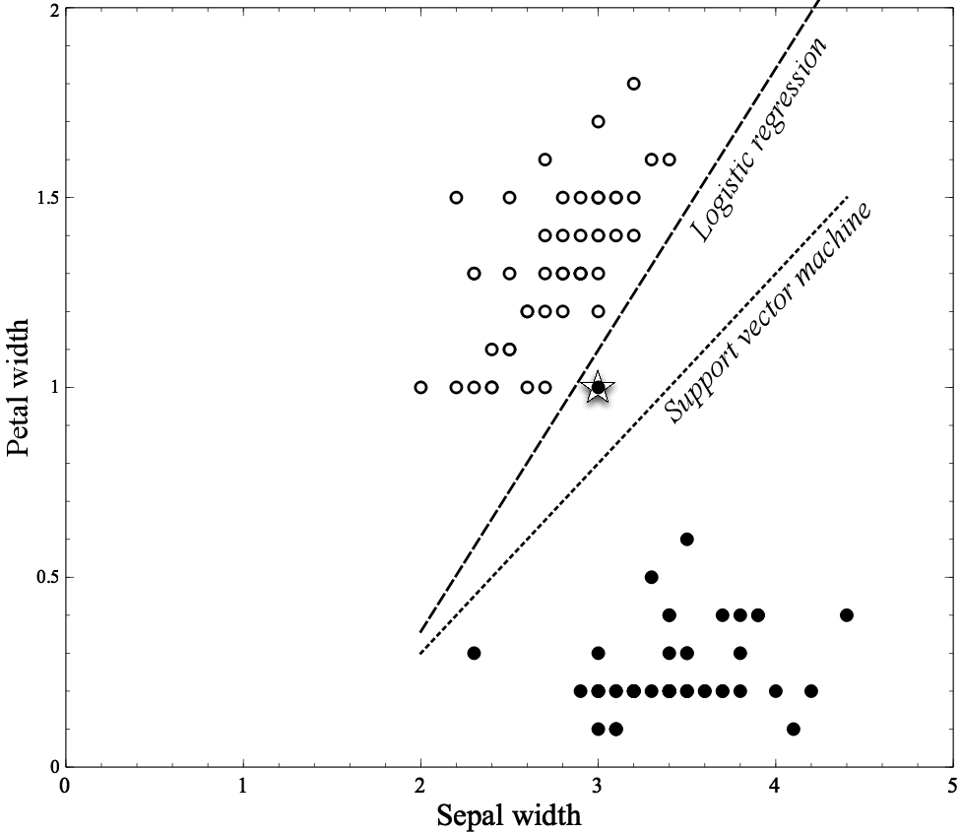
Example: Classifying Flowers

Slide 16
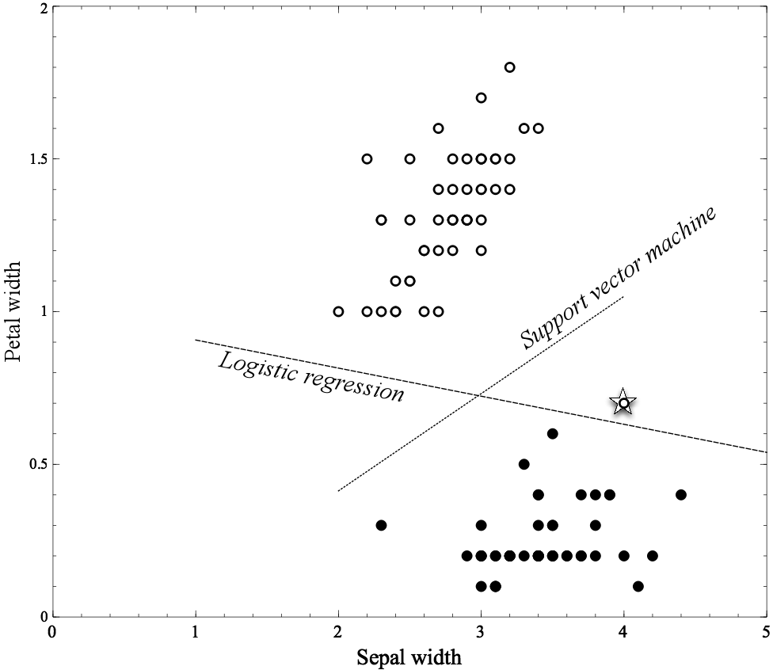
Example: Classifying Flowers

Slide 17
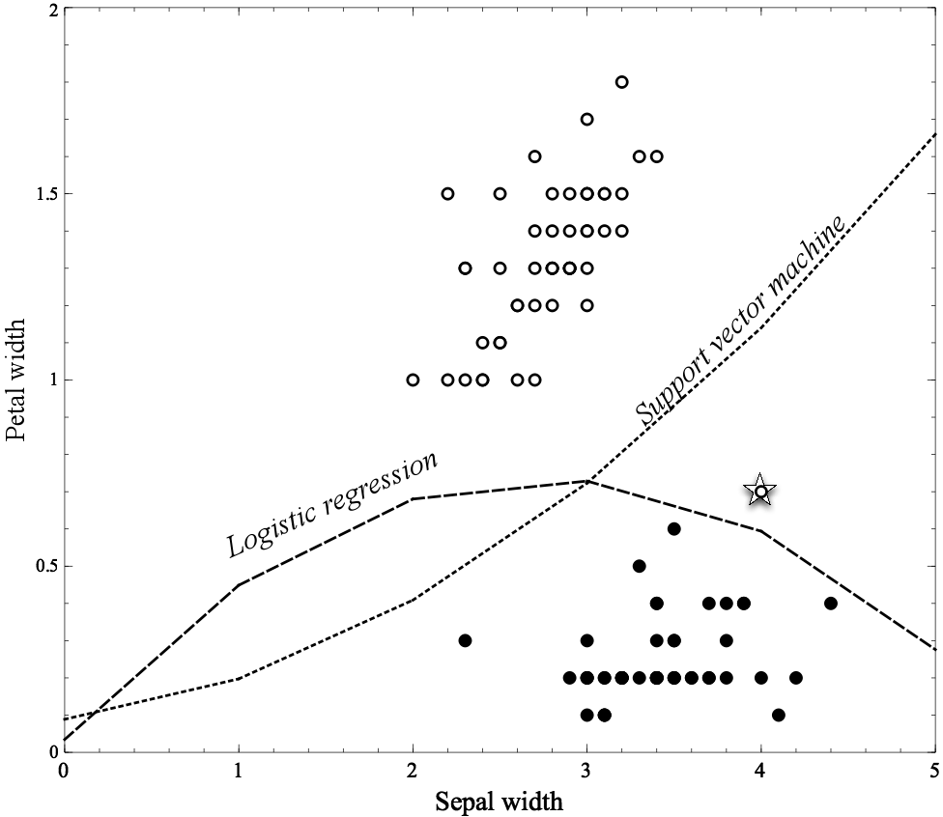
Example: Classifying Flowers

Slide 18
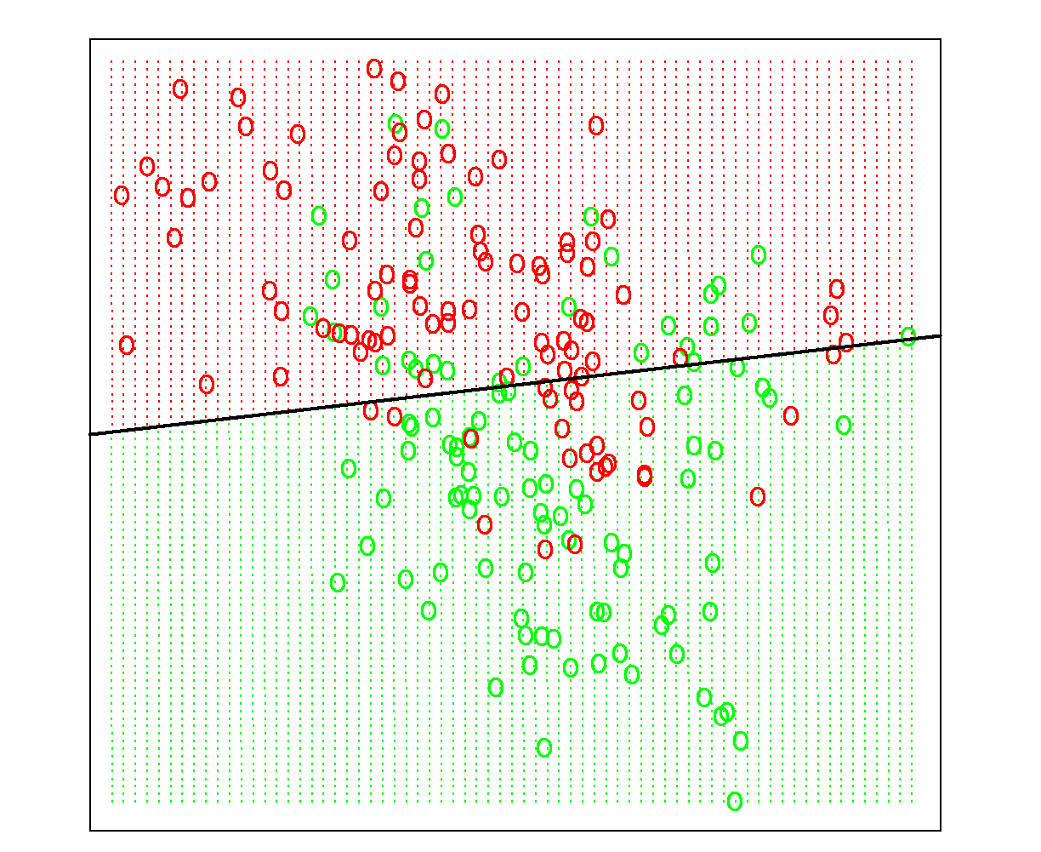
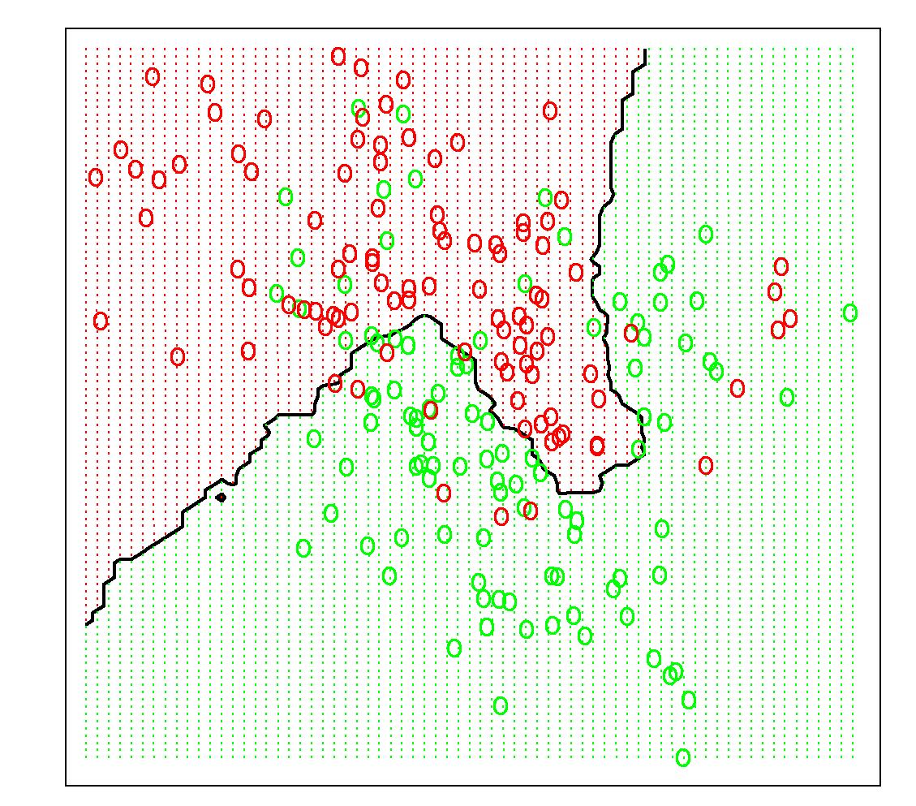
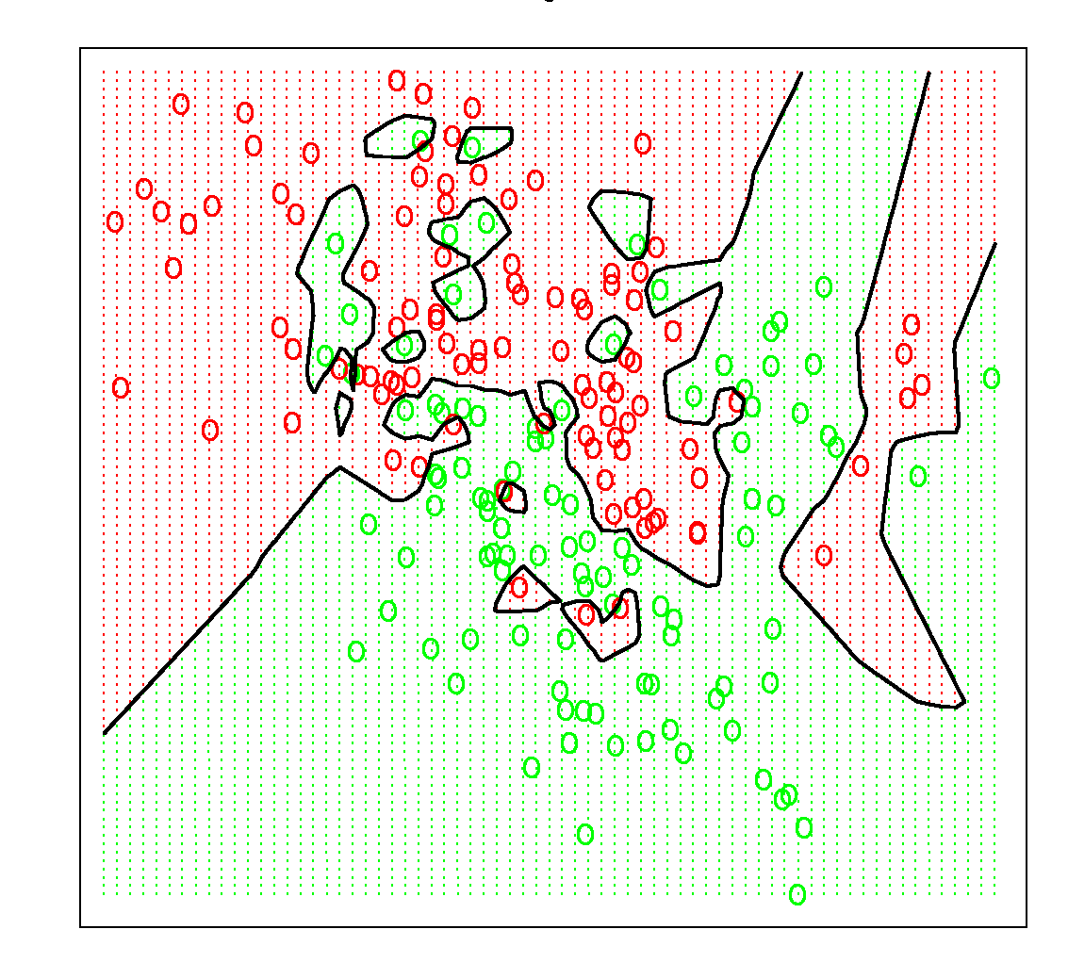
Need for holdout evaluation
Under-fitting Good Over-fitting
In-sample evaluation is in favor or “memorizing”
On the training data the right model would be best
But on new data it would be bad

Slide 19
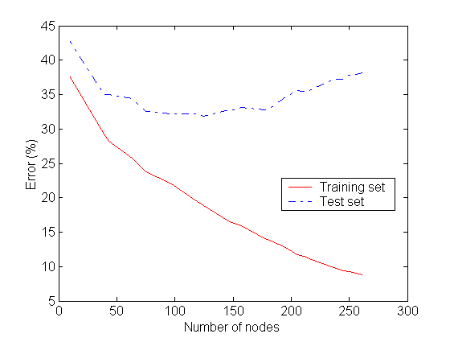
Over-fitting
Under-fitting
Over-fitting
Good Fit
Over-fitting: Model “memorizes” the properties of the particular training set rather than learning the underlying concept or phenomenon

Slide 20

Holdout validation
We are interested in generalization
The performance on data not used for training
Given only one data set, we hold out some data for evaluation
Holdout set for final evaluation is called the test set
Accuracy on training data is sometimes called “in-sample” accuracy, vs. “out-of-sample” accuracy on test data

Slide 21
Evaluation option 2 revisited
What’s wrong with this approach?
Option 2 – “holdout” a sample of your data to use as a “test” set.
Train
Use to induce…
Test performance on…
Model
Holdout
Holdout

Slide 22
Third option… cross-validation (x-val): an alternative to holdout testing

Slide 23
Cross-Validation: Establishing Modeling Performance
Repeat this whole process for multiple modeling approaches. Compare “test sample performance” measures. This tells you which modeling approach is best.

Slide 24
From Holdout Evaluation to Cross-Validation
Not only a simple estimate of the generalization performance, but also some statistics on the estimated performance,
such as the mean and variance
Better use of a limited dataset
Cross-validation computes its estimates over all the data

Slide 25
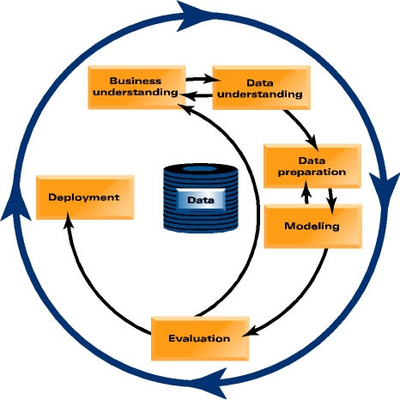
Let’s focus back in on actually mining the data..
Which customers should TelCo target with a special offer, prior to contract expiration?

Slide 26
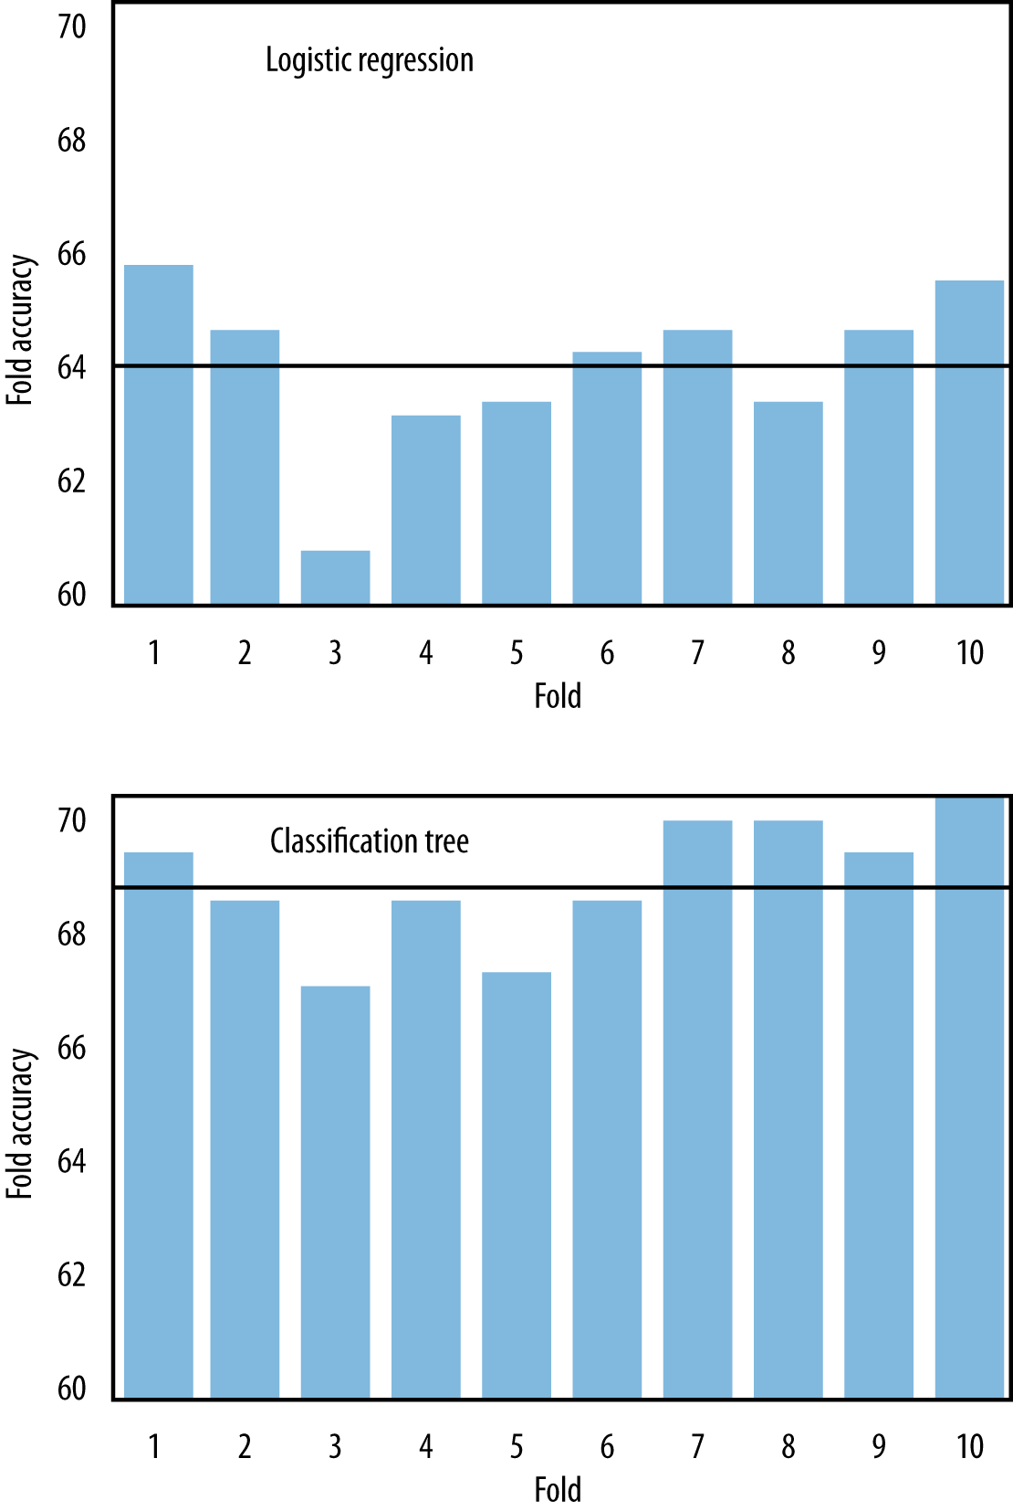
MegaTelCo

Slide 27
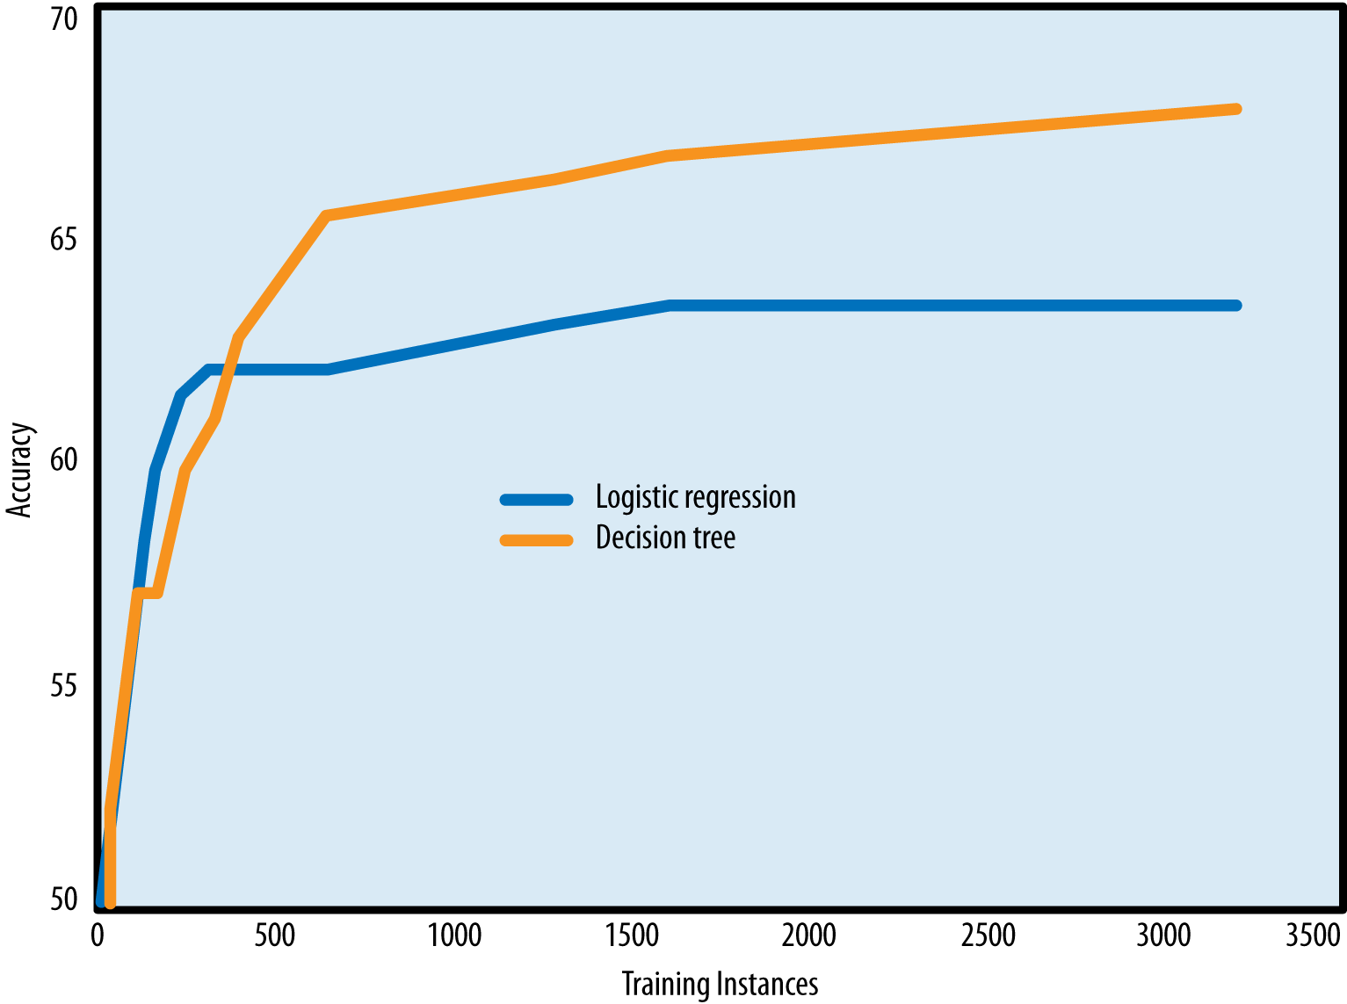
Learning Curves

Slide 28
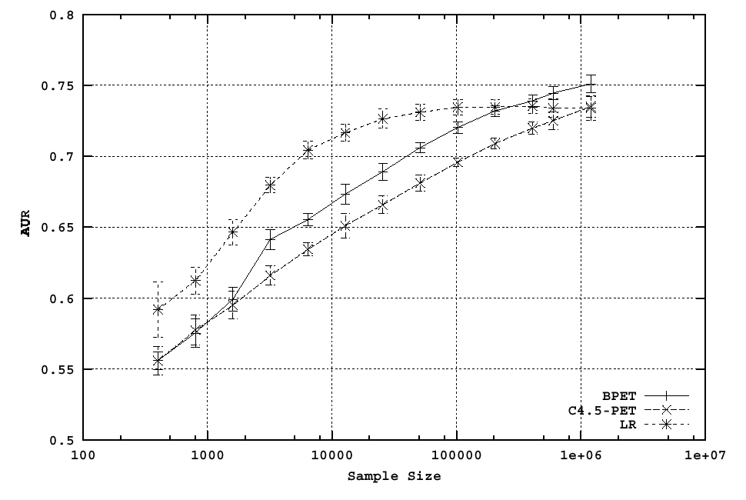
Comparing learning curves is essential
Which model do you think will be best as the training sample size gets bigger?

Slide 29
Comparing learning curves is essential
YOU WERE WRONG

Slide 30
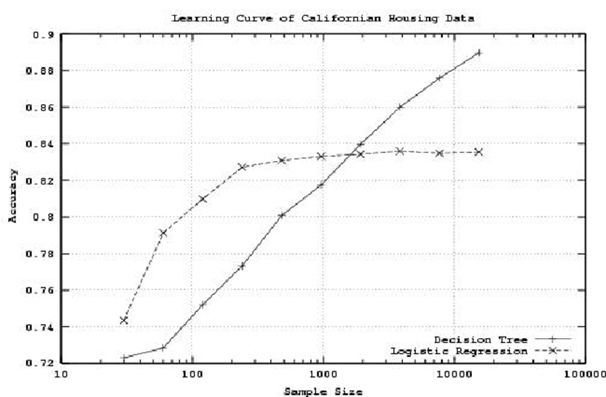
Choice of algorithm is not trivial!

Slide 31
Logistic Regression vs Tree Induction
For smaller training-set sizes, logistic regression yields better generalization accuracy than tree induction
For smaller data, tree induction will tend to over-fit more
Classification trees are a more flexible model representation than linear logistic regression
Flexibility of tree induction can be an advantage with larger training sets:
Trees can represent substantially nonlinear relationships between the features and the target

Slide 32
Learning curves vs Fitting graphs
A learning curve shows the generalization performance plotted against the amount of training data used
Can help answer the question, “should we pay to obtain more data”?
DataRobot shows learning curves (let’s look)
A fitting graph shows the generalization performance as well as the performance on the training data, but plotted against model complexity
Fitting graphs generally are shown for a fixed amount of training data

Slide 33
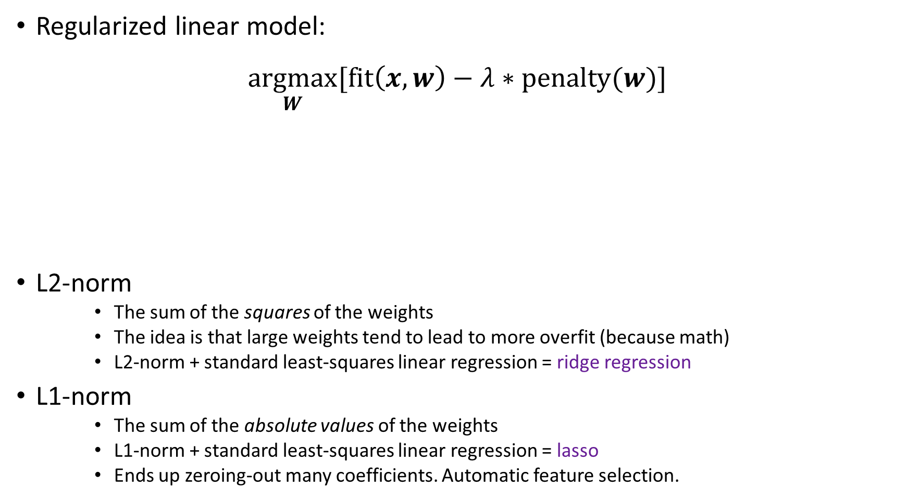
Regularization
Regularized linear model:
$$\underset{W}{argmax}{[\text{fit}\left(x,w\right)−λ∗\text{penalty}(w)]}$$
L2-norm
The sum of the squares of the weights
The idea is that large weights tend to lead to more overfit (because math)
L2-norm + standard least-squares linear regression = ridge regression
L1-norm
The sum of the absolute values of the weights
L1-norm + standard least-squares linear regression = lasso
Ends up zeroing-out many coefficients. Automatic feature selection.
We’re interested in the set of weights (w) that maximize the value on the right
Calculate how well a set of weights (w) fit the actual values (x), but penalize the fit statistic by the size of the weights (w)

Slide 34
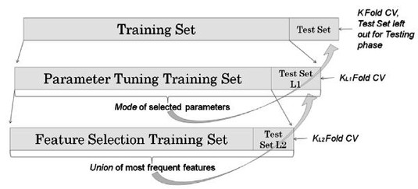
Nested Cross-Validation: 3-level
Split your data into “folds”. Hold out one fold for testing. Combine all other folds and send them down to the next level.
Use average results from the lower level to train. Then, hold out a different fold for testing, and send down the rest to the next level. Repeat until all folds have been used for testing.
Split this data into “folds”. Hold out fold for testing. Combine all other folds and send them down to the next level.
Use average results from the lower level to train. Then, hold out a different fold for testing, and send down the rest to the next level. Repeat until all folds have been used for testing.
Split this data into “folds”. Hold out one fold for testing. Train on al other folds.
Inception!
Hold out a different fold for testing. Repeat training. Repeat until all folds have been used for testing.

Slide 35
How many training sessions would that be?
30 Training Sessions for 2-level nested CV

Slide 36
Data Robot does partitioning for you. Let’s look
https://app.datarobot.com/docs/users-guide/more-info/data-partitioning.html?highlight=holdout
Data Robot splits your dataset several times
Once into a “train-test” split
They call the “test” a “holdout”
And then a cross-validation is run on just the “train”
you can “unlock” the holdout later to test your CV’ed models
Let’s use the lending club “no target leak” sample dataset…

Slide 37
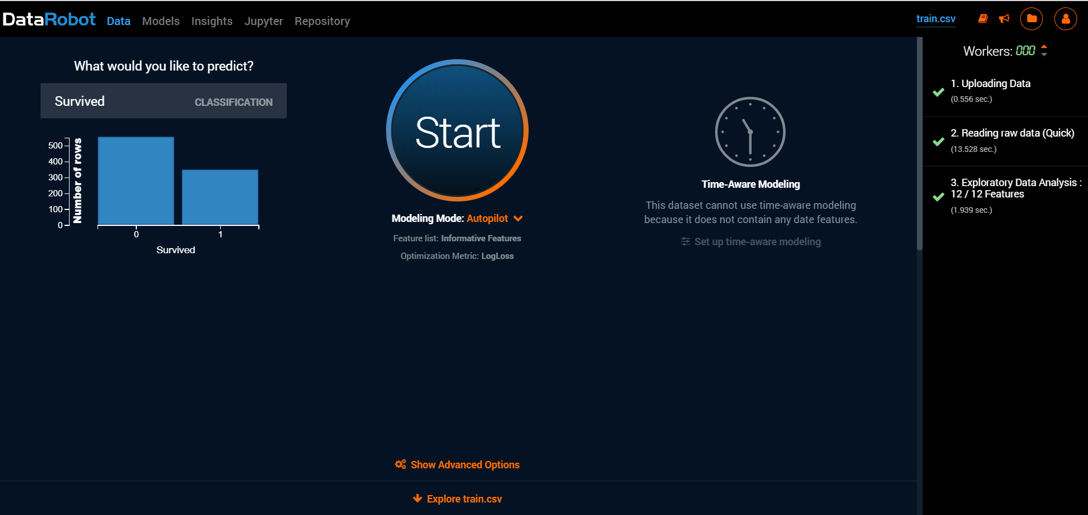

Slide 38
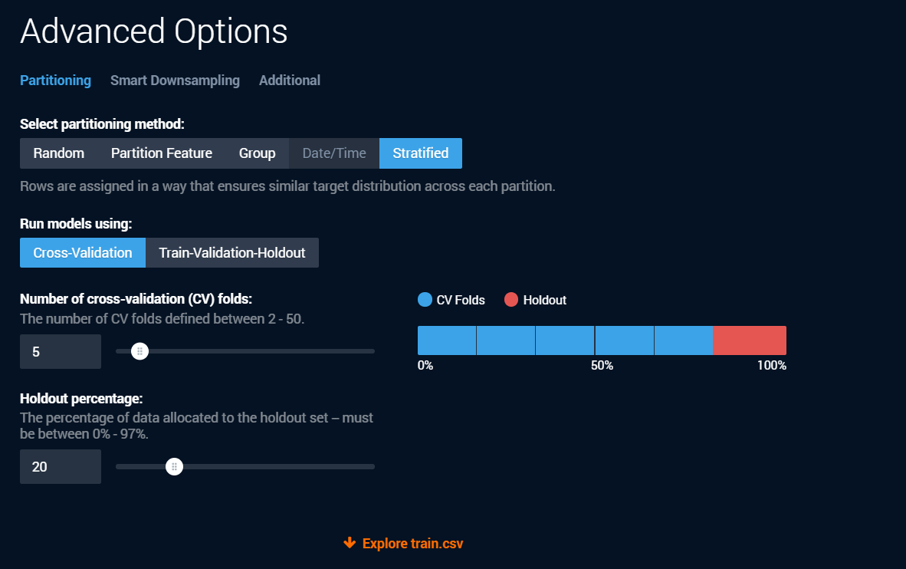

Slide 39
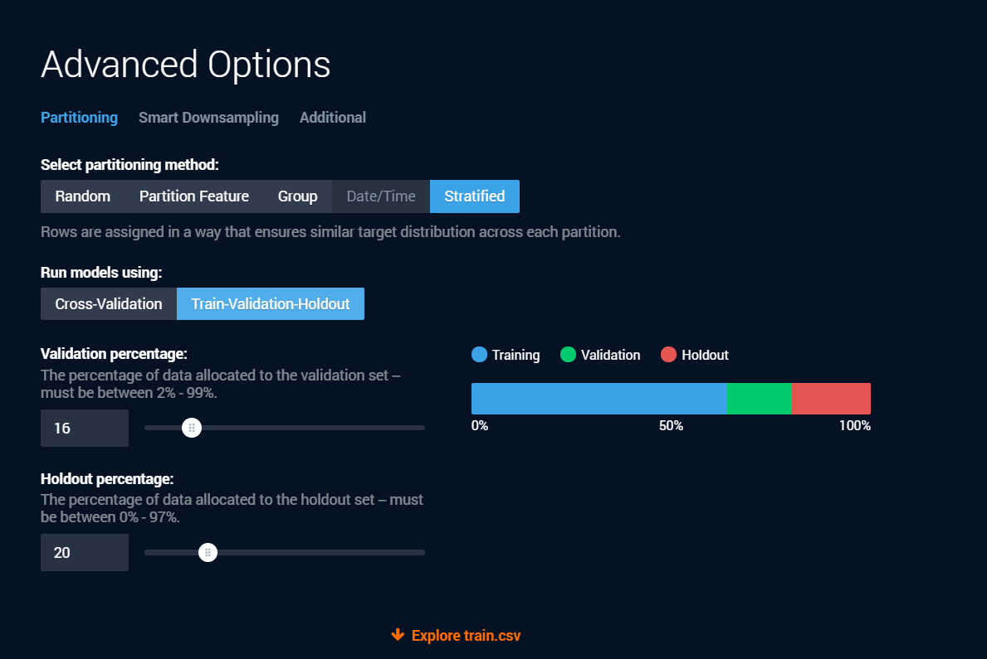

Slide 40
Many figures in this slide deck from Provost, F., & Fawcett, T. (2013). Data science for business: what you need to know about data mining and data-analytic thinking. Sebastopol, Calif.: O'Reilly.

